Slide 1
Data Technology Roles Analysis

Slide 2
description
This dataset originates from a questionnaire conducted by YouTuber Alex The Analyst, exploring various aspects of data technology roles, which are increasingly shaping industries worldwide. I performed a comprehensive analysis of the data, incorporating advanced visualisation techniques to extract meaningful insights. My work highlights key trends, industry demands, and the evolving landscape of data tech roles, providing valuable perspectives on the future of this field.

Slide 3
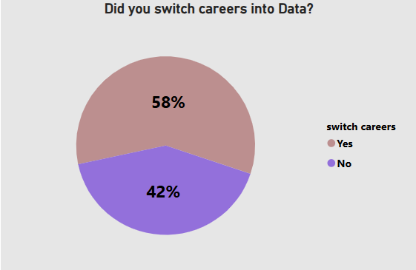
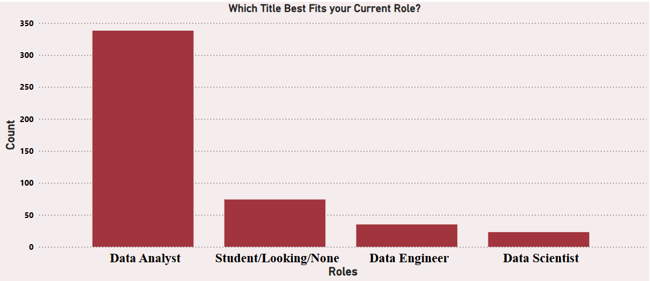
Data role
showing question did u switch to data with58% yes answer
current roles with data analyst at the top

Slide 4
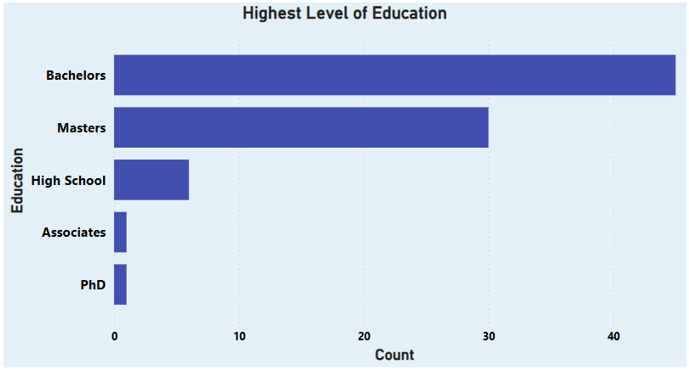
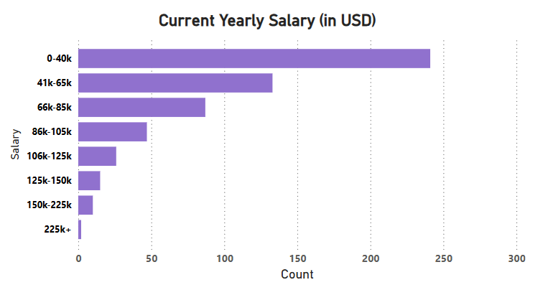
Level of Education and salary distribution
Level of education with bachelors at the first rank
Salary distribution with average of 41k – 65k

Slide 5
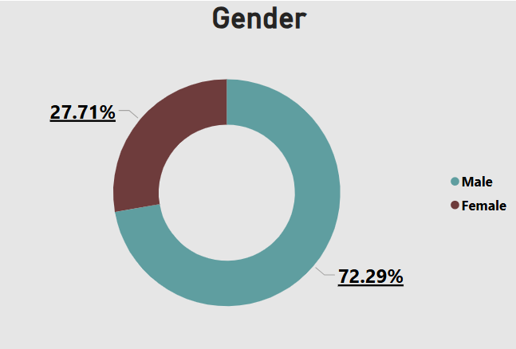
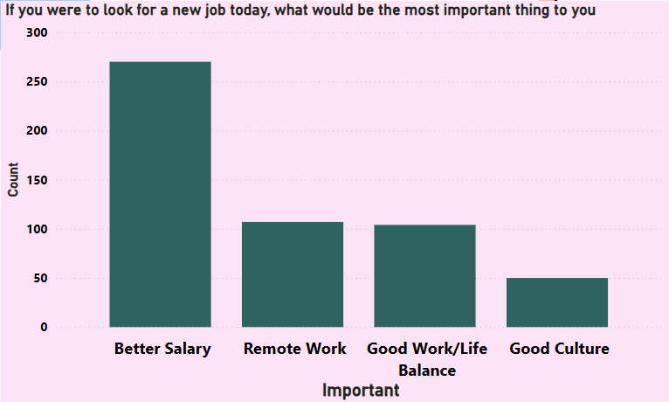
Job looking priority and gender
Gender with male at first
Better salary the priority that people are used when looking for new job

Slide 6
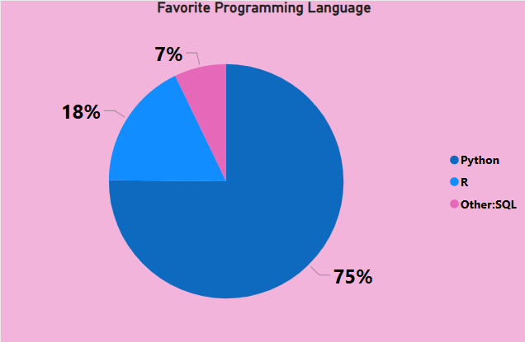
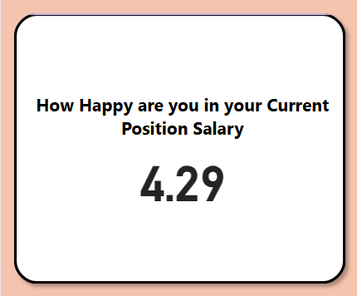
Programing language and happiness at salary
Favorite programing with python at the front
Happiness with salary at 4.29 out of 10

